Slide 1
More Models
Reasoning and Abstraction

Slide 2
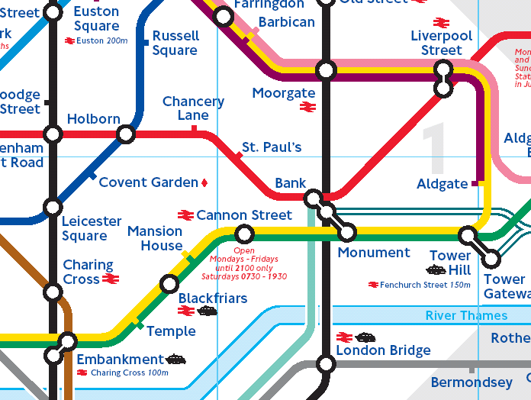
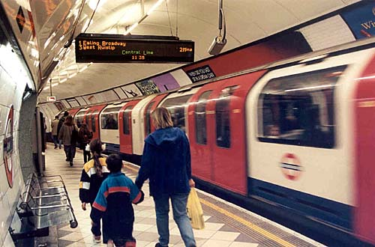
Models
Signs
Symbolic Models
Iconic Models
Analogic Models
 
Static Models
Dynamic Models

Slide 3
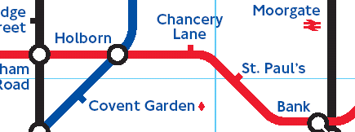
Analogic Models
Analogic models
  Have something in common with their ‘real world’ counterparts
  In the ‘real thing’ Holborn is on the same line as Bank
  In the model Holborn is on the same line as Bank

Slide 4
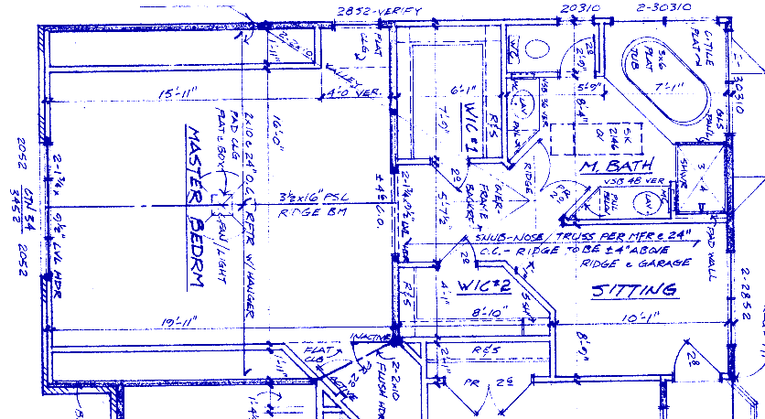
Analogic or Iconic?

Slide 5
Analogic or Iconic?
Typically…
  Merely scaling does not produce an analogic model.
  Where one measurable phenomena is used to represent another, different measurable phenomena there is a classic analogy.
  The phenomena are usually physical.
  There is overlap.

Slide 6
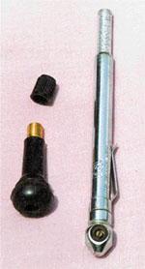
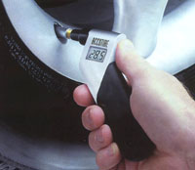
Analogic or Symbolic?
Pressure gauges
Dipping a heating oil tank with a
broom handle
The waterline on a ship

Slide 7
Classification
Not all models can be cleanly classified into
  Symbolic
  Iconic
  Analogic
It is important to highlight the aspects of the model that suggest how a model may be classified.

Slide 8
Specifications as Models
Main Specifications
Product Description: Freecom Classic Mobile 2.5" Hard Drive USB-2 - hard drive - 80 GB - Hi-Speed USB
Type: Hard drive - external
Form Factor: 2.5"
Dimensions (WxDxH): 7.2 cm x 12.8 cm x 1.2 cm
Weight: 0.4 kg
Capacity: 80 GB
Interface Type: Hi-Speed USB
Data Transfer Rate: 480 Mbps
Average Seek Time: 13 ms
Buffer Size: 2 MB
OS Required: Microsoft Windows 98SE/2000/ME/XP

Slide 9
Specifications as Models
What was not mentioned:
  It’s matt black.
  It has some flashing LEDs.
  It comes with a warranty.
  It seems to work fine with Linux.
Why?
  Because most people don’t care very much about those things, initially…

Slide 10
Abstraction
Highlight the relevant (important) details or
  ATTRIBUTES
Leave out the irrelevant details
Focus on the essence
A model is, by its nature, abstract

Slide 11
Abstraction
This is a ‘good enough’ model to accomplish a few common tasks for most users.
There’s usually enough information in the specification to decide whether or not the drive is adequate.
There’s no need to see the drive itself or seek an exhaustive specification.
The creator of the abstraction has saved us the bother of sifting through unnecessary detail.

Slide 12
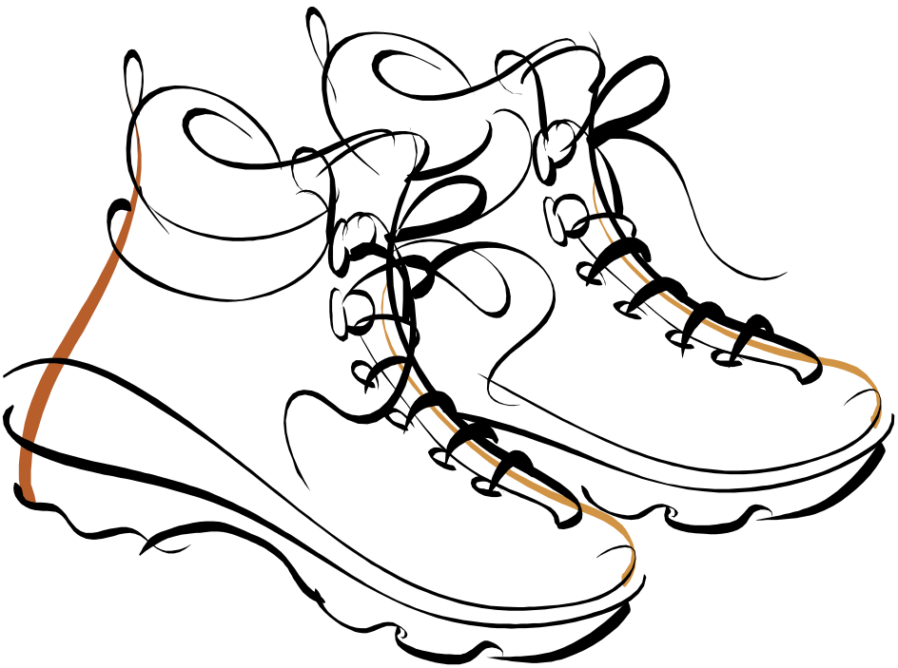
Specifications
Design a specification template for a shoe.

Slide 13
Abstraction
What are these things that we leave in or leave out of abstractions/models?
ATTRIBUTES
We model some ATTRIBUTES of the ‘real thing’
We do not model all ATTRIBUTES

Slide 14
Abstraction
To aid reasoning
  How many bricks it will take to build a house?
What can you not tell from the blueprint?

Slide 15
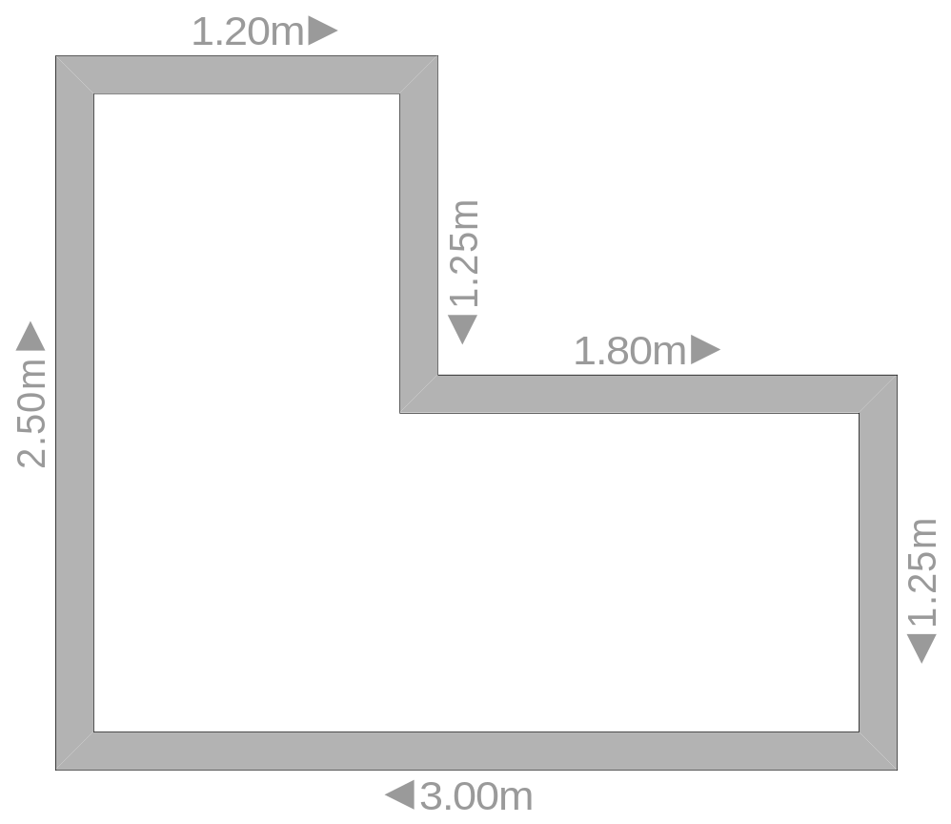
Reasoning with Abstractions
Floor Tile
100mm
Room
Block
215 X 103 X 50mm

Slide 16
Reasoning with Abstractions
Too much detail was left out
  The height of the walls was not specified
  We appear to have outside measurements for the walls
Lets look a some models in practice…..

Slide 17
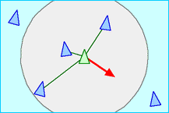
Boids
Model of flocking behaviour of birds
Attributes considered in the model
  Separation, Alignment, Cohesion
  (Images taken from http://www.red3d.com/cwr/boids/applet/ )
Separation
  Don’t hit other birds

Slide 18
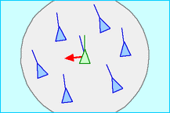
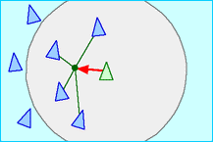
Boids
Alignment
  Go in same direction as other birds
Cohesion
  Don’t go too far from other birds

Slide 19
Boids
Boid Demos
http://ie.youtube.com/watch?v=XH-groCeKbE
http://ie.youtube.com/watch?v=GUkjC-69vaw
http://ie.youtube.com/watch?v=6NWJCIypCvg

Slide 20
Models
Robocode
  Model of physics
  Entrants write model of tank controller

Slide 21
Models
Geosimulation:
  Crowd dynamics
  Model includes
    Map of area
    Behaviour of individuals
  Model shows result of crowd interactions
  http://www.geosimulation.org/crowds/

Slide 22
Models
Traffic simulation:
http://www.traffic-simulation.de/
  Model
  Behavior of cars
  Road layout
TORCS
http://torcs.sourceforge.net/
Model of physics
Entrants write controller for car
http://ie.youtube.com/watch?v=djbfI_3IjmU&feature=related

Slide 23
Optimization
Linear Programming Problems
  Optimization Problem
  Constraint functions are linear
  Objective function is linear
  E.g. Max: x+y
  Subject to x>0, y>0, x<=5, y<=3

Slide 24
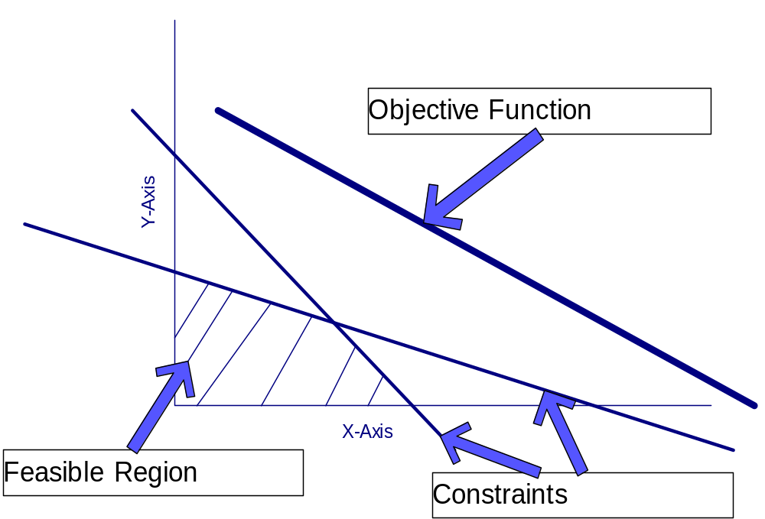
Optimization

Slide 25
Problem Solving 1
The Precision Tool Company(PTC)
  PTC is a manufacturer of precision screws. It has two main lines, wood screws and metal screws which it sells for 20 and 25 euro respectively per box. The material costs for each box are 10, 8 euro respectively and overhead costs are 5000 euro per week. All screws have to pass through a slotting machine(SM) and threading machine(TM). A box of wood screws requires 3 mins in the SM and 2 mins in the TM. A box of metal screws requires 2 mins on the SM and 8 mins on the TM. In a week each machine is available for 60 hours

Slide 26
Problem Solving 1
Formulate this problem as an optimization problem. Draw a graph which includes all the constraints and the optimization function. Determine the optimal solution.

Slide 27
Summary
More Models: Iconic, Symbolic, and Analogic
Classification of Models
Abstraction and Reasoning
Examples of Modelling
Optimization and problem solving

